Slide 1
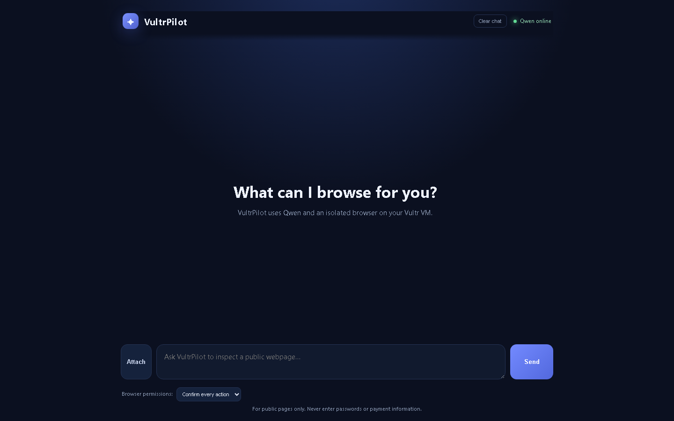
VULTR AGENT RUSH · CHALLENGE 1
VultrPilot
A Qwen-powered browser and code agent with a zero-trust execution boundary.
Live demo · vultrpilot.baharsoftbd.com

Slide 2
THE PROBLEM
Browser automation needs a safety boundary
A useful agent must act on real pages, yet every action needs evidence, control, and containment.
Today’s browser agents often jump from intent to action. That creates three gaps:
VultrPilot
1
No visual proof that the target is correct
Qwen plans the task
2
Vision verifies the screenshot
No human checkpoint before the final click
A person approves the action
3
No clear boundary for code or browser work
The work runs inside Vultr

Slide 3
SYSTEM ARCHITECTURE
One control layer, three contained services
The public chat coordinates planning, verification, browser work, and disposable code execution.
Vultr Serverless Inference
FastAPI on Vultr VM
Qwen3-8B planning + Qwen vision
User chat
→
Calls Qwen over HTTPS\nApproval + session state\nArtifact packaging
→
Prompt + annotation
Isolated Playwright runner
HTTPS-only Chromium + screenshots
Disposable Python executor
network_mode: none + resource limits
Vultr Cloud Compute VM
FastAPI runs on the VM and calls Vultr Serverless Inference for Qwen. HTTPS enters through Caddy.

Slide 4
BROWSER ACTION FLOW
Evidence comes before the click
The default mode keeps the user in control of every browser action.
01
02
03
04
05
User goal
→
Screenshot
→
Vision check
→
Approval
→
Result
“Find the first Vultr video”
Runner returns the live page
Qwen identifies the marked target
User selects Approve action
Runner clicks and reports output
The final action is gated by a human approval event.
Quick approve and autopilot exist for controlled demos, but confirmation is the default.

Slide 5
CONTAINMENT
The blast radius stays small
VultrPilot treats browser work and generated code as untrusted operations.
Browser runner
Python executor
• Only valid HTTPS public pages
• Headless Chromium in its own container
• Resource limits and dropped capabilities
• Screenshot returned before action
• Separate disposable worker
• network_mode: none
• Read-only filesystem + /tmp
• CPU, memory, process, file, and time limits
A containment moment to show in the demo: the executor runs without a network interface.

Slide 6
DEMO STORY
A real task with a visible checkpoint
The demo makes the safety model easy to see in under two minutes.
1
Ask VultrPilot to search YouTube for “vultr”
Live demo
2
Annotate the result and choose Add to chat
https://vultrpilot.baharsoftbd.com
3
Watch Qwen vision describe the marked target
Human approval
Vision verification
Browser screenshot
4
Approve the action and see the isolated browser result

Slide 7
CHALLENGE FIT
Built for Blast Radius Zero
VultrPilot maps directly to the required Challenge 1 pattern.
Vultr Cloud Compute VM
Submission links
FastAPI control plane, Caddy HTTPS, runner, and executor
Live demo
vultrpilot.baharsoftbd.com
GitHub
github.com/zakirhossen23/VultrPilot
Vultr Serverless Inference
Qwen3-8B for planning and qwen3.8-27b for screenshot verification
Verifiable execution
Real browser screenshots, approval events, click results, and downloadable ZIP artifacts
VultrPilot turns a browser agent into a reviewable, contained workflow.

